Slide 1
Array Data Structure
Lectured by
Maksuda Rabeya

Slide 2
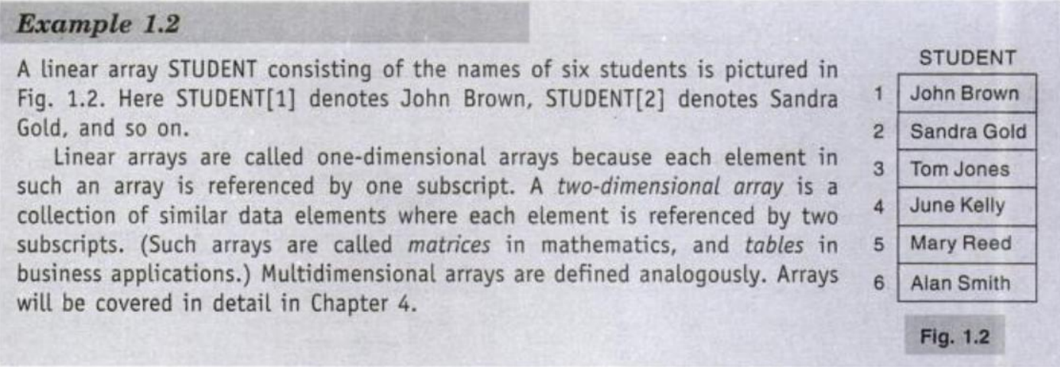
Introduction to Array

Slide 3
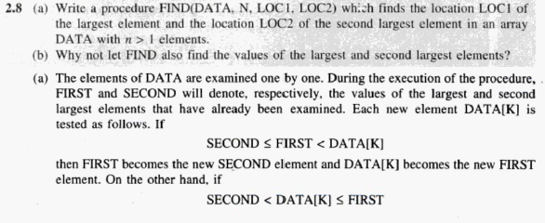
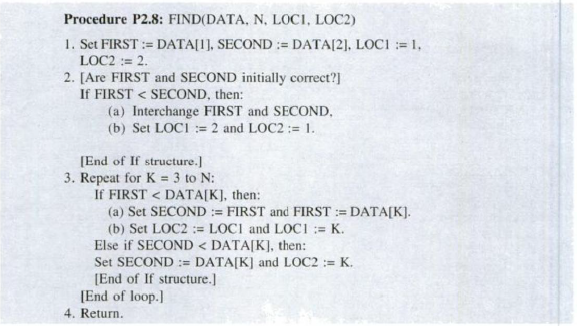
How data structure defined for array problem

Slide 4
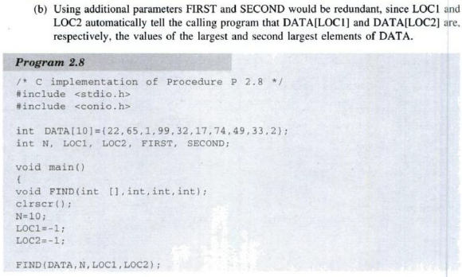

Slide 5
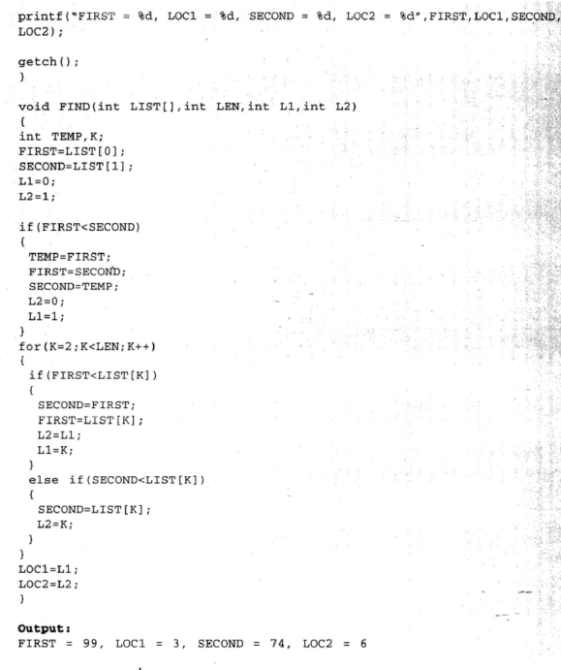

Slide 6
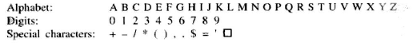
Basic Terminology of String

Slide 7
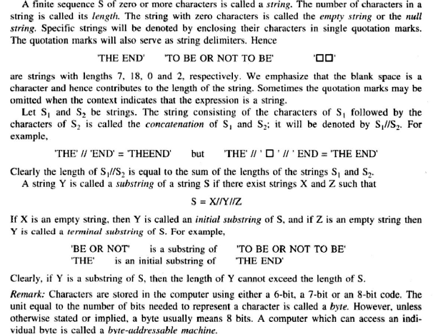
String Process

Slide 8
String should have operations
Return the nth character in a string to C
Set the nth character in a string to C
Find the length of a string
Concatenate two strings
Copy a string

Slide 9
Substring
SUBSTRING(string, initial, length)
SUBSTRING(‘TO BE OR NOT TO BE, 4, 7)= ‘ BE OR N’
SUBSTRING(‘THE END’,4,4)=‘ END’

Slide 10
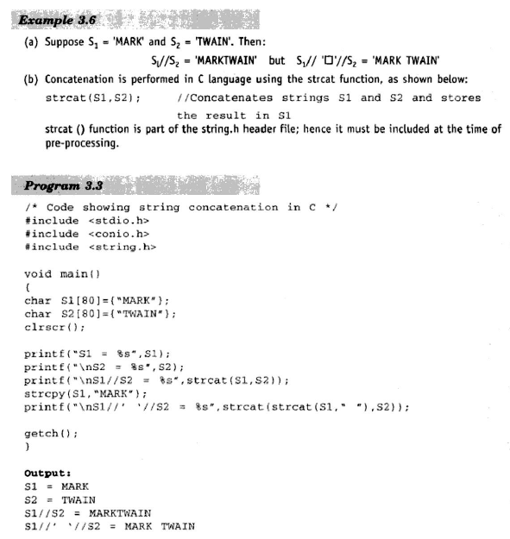
Concatenation

Slide 11
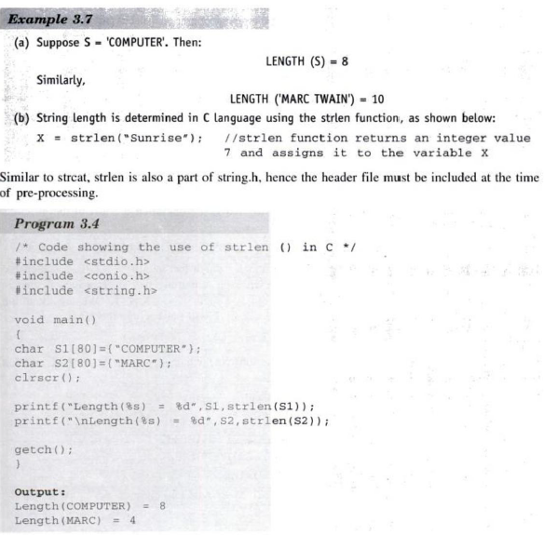
Length

Slide 12
Word or Text Processing
Replacement. Replacing one string in the text by another
Insertion. Inserting a string in the middle of text
Deletion. Deleting a string from the text

Slide 13
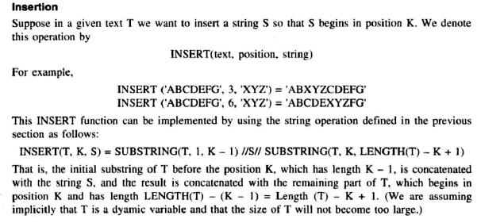

Slide 14
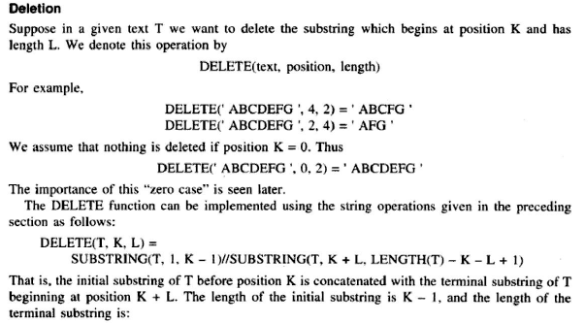
Deletion

Slide 15
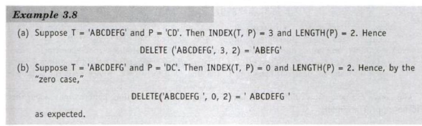

Slide 16
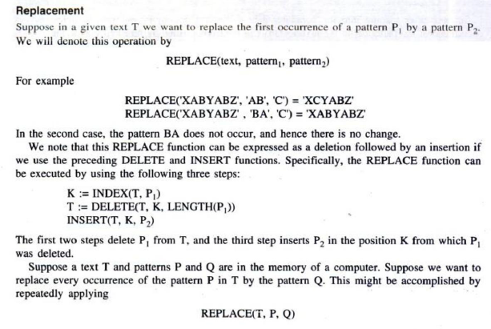

Slide 17
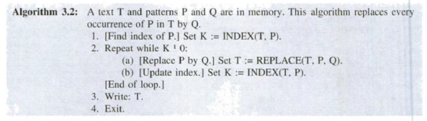

Slide 18
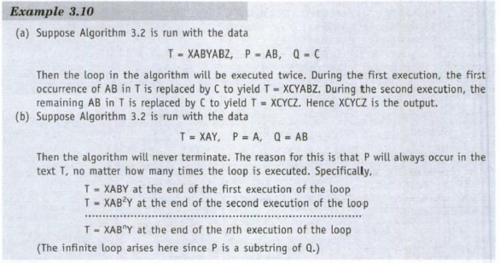

Slide 19
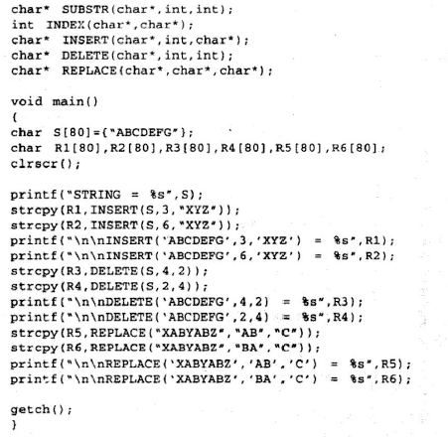
Main function of Insertion, deletion, replace code.

Slide 20
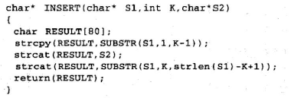

Slide 21
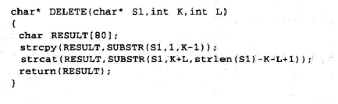

Slide 22
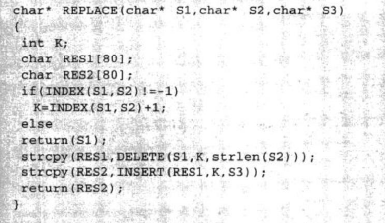

Slide 23
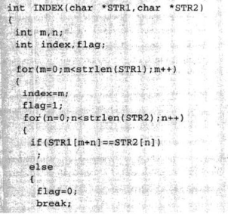
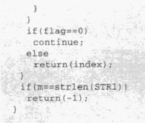

Slide 24
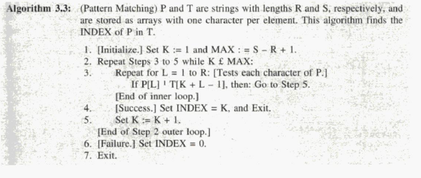
Pattern Matching

Slide 25
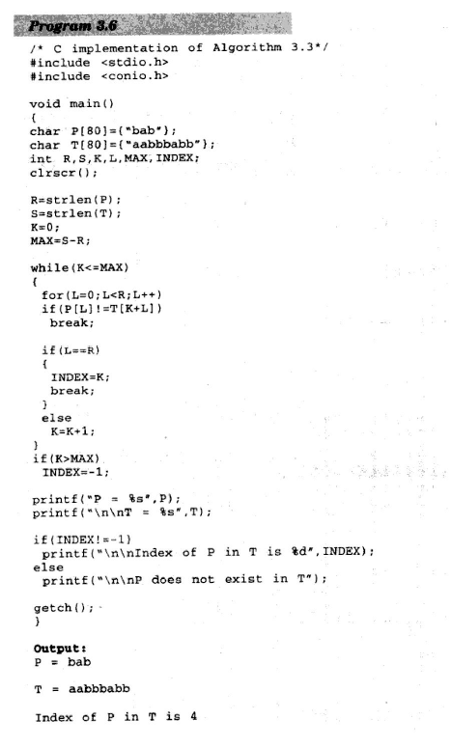

Slide 26
Thanks for your patience ☺
Reference book
Data Structures with c by schamu series

